Slide 1
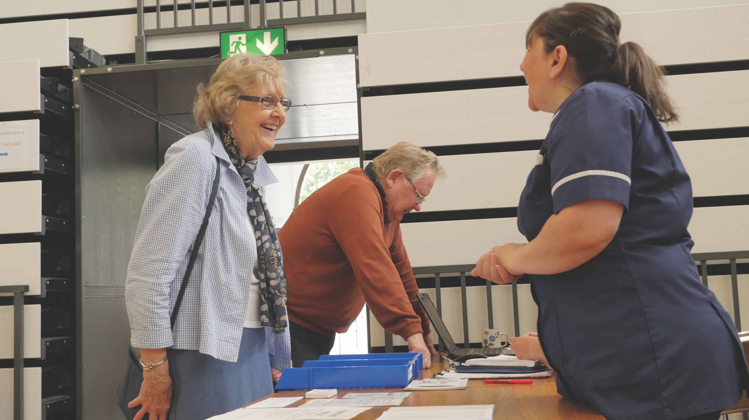
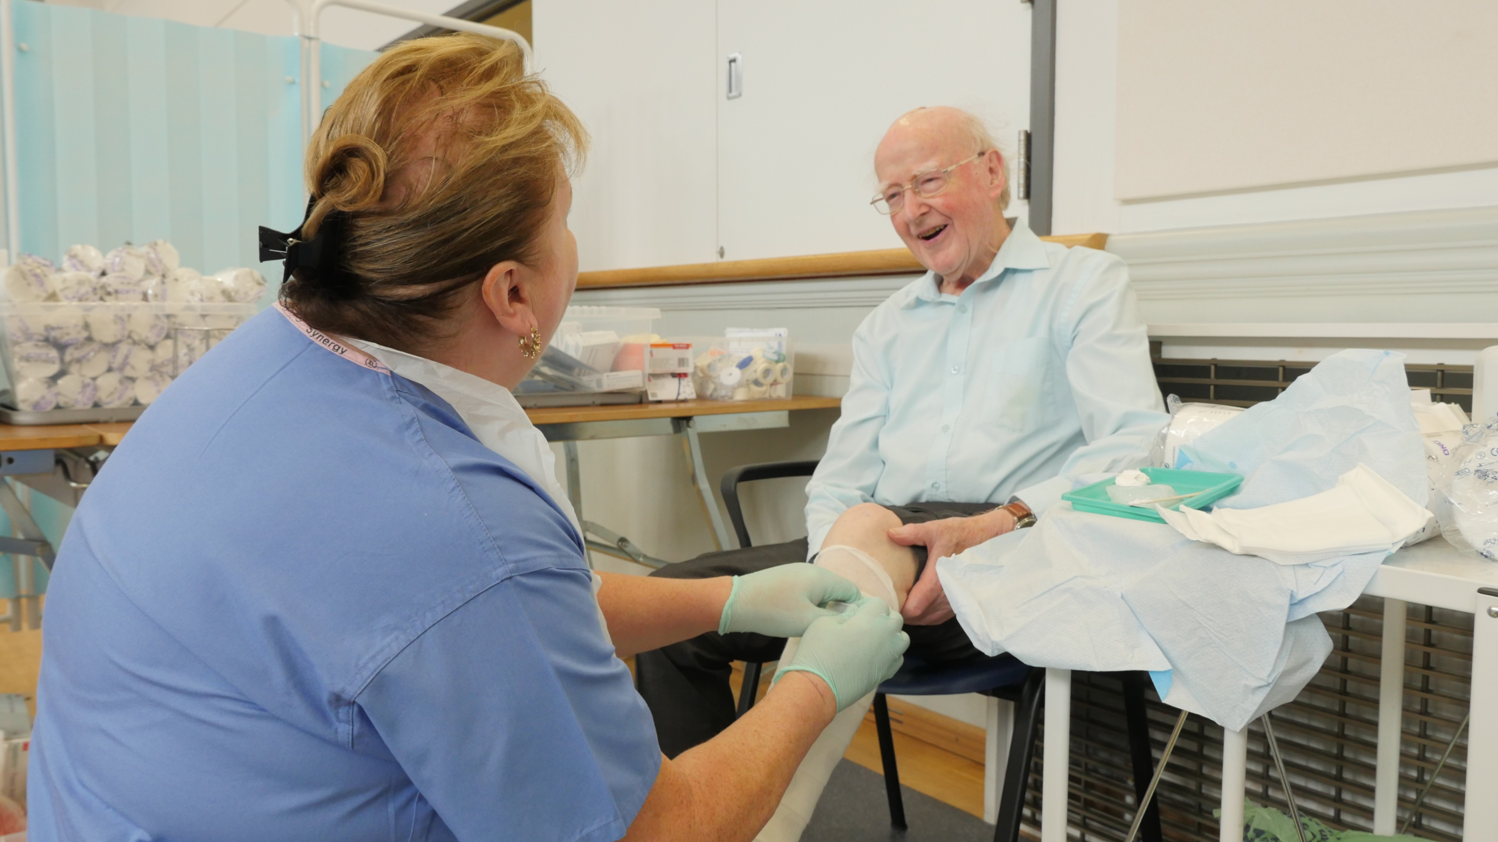

A person-centred approach to lower limb care: myth or reality? Ellie Lindsay, OBE FQNI, Visiting Fellow, Queensland University of Technology and Joan-Enric Torra PhD, University of Lleida, Spain
As we age there is also the increasing likelihood of living and having to cope with one or more chronic diseases. Leg ulcers are a major subset of chronic wounds. They are far more common than most of us realise, and frequently lead to clinical depression, social isolation, a marked deterioration in overall quality of life and poor clinical outcomes.
A major challenge in a world where populations are ageing is in finding meaningful ways for people to experience good quality of life while continuing to participate in and contribute to society.
The values of person-centred care are the practice of caring for individuals (and their families) in ways that are meaningful and valuable. Yet we continue to fail our patients, even when we know that they are our first priority.
Modern day, person-centred care demands many disciplines and skills other than those supplied by the medical and nursing profession. Prime consideration should be given to an individual’s wants and feelings when planning care. That requires increasing attention to be paid to the human dimension of an individual’s health needs.
Background
Of the many presentations across the clinical spectrum of chronic venous disease, venous leg ulceration can be considered amongst the most important. The psychosocial economic Leg Club model of lower limb care was specifically designed to provide a social empowerment framework for people suffering from or at risk of problems of the lower limb and leg ulceration.
The core concept of holistic care and its application to wound management is looking at the whole person, not just the wound. That is clearly demonstrated within a psychosocial Leg Club environment where the clinical and volunteer team consider the needs of each individual member (patient) using a multidisciplinary approach.
Most nurses providing lower limb and leg ulcer management have not got or had experience of living with a leg ulcer and all the associated factors. Yet, they are very aware that, for many, living with the condition can often lead to experiencing social stigma, depression, a lack of wellbeing and a poor quality of life as leg ulcers can be unsightly, painful and malodorous.
Method
The social model of care attempts to address the broader influences on health, social, cultural, environmental and economic factors as opposed to just disease and injury. The Leg Club Foundation Charity spent many years identifying the best methods for creating a data entry system that is robust, simple to use at the local level but that can be analysed in a variety of ways at the macro level.
Care pathways in a Leg Club are individualised and involve a two-way relationship between the member and clinicians, in which they are encouraged to be equal partners. As advocates, the team provides members (patients) and their families with sufficient information to enable them to navigate and play an active part in their treatment pathway.
By providing transparency in information-sharing, they can facilitate the members, and their families, to be in control of their care. Just as gratifying, we have found that the members of the Leg Clubs experience companionship and become once again fully integrated into their communities, and thereby are given new meanings to and wellbeing in their lives.
Results
One priority of Leg Club research was to examine effectiveness in terms of not only clinical outcomes but also member satisfaction, quality of life, wellbeing, and cost-effectiveness.
Building an evidence base is one of the Foundation’s key priorities in order to reassure clinicians and demonstrate to them and their NHS provider how basic digital Leg Club information sharing services can really transform lower limb health care in a positive way. Recent research demonstrated high levels of satisfaction with nursing staff, which is very encouraging. It demonstrates that the nursing care that members receive is at least as high as it would be in a traditional clinical environment, and that that is recognised by those receiving the care.
Initial work on wellbeing suggests that the model improves wellbeing, and that social interaction has a key part to play in that aspect of holistic management. Members’ shared experience appears to be the influencing factor here; further qualitative research could be extremely useful in assessing that issue.
Discussion
Medical technology in lower limb and wound management is evolving continually and there are currently new and progressive ways in which leg ulcers can be managed. However, an entrepreneurial approach to management of the lower limb relies on clinicians working collaboratively as a multidisciplinary team to ensure that standards in the quality of an assessment of the lower limb, person-centred wound management and wellbeing are high priority.
With the escalated exposure of the Leg Club model comes the increased need to demonstrate its effectiveness and the Foundation is now focusing on producing evidence in outcomes, recurrence and cost-effectiveness.
Creating informatics is one of the key priorities for the Leg Club Foundation as that demonstrates to the clinician and NHS provider how basic digital information-sharing can provide evidence and really change within a Leg Club. Since the introduction of digital technology within the Leg Club network, the board of Trustees is now starting to obtain good evidence.
Conclusion
Patient-centred care is referred to frequently in medicine but its comprehensive application to wound management is both complex and overdue. The core concept of person-centred care and its application to lower limb management is looking at the whole person, not just the wound.
The Leg Club model moves firmly from the ‘paternal’ model of care delivery in a ‘clinical’ environment, to delivery in a familiar place of social activity in the community, such as a church hall, village hall or similar. That fosters a friendly and welcoming environment, where the members are motivated and empowered to take ownership of their own care, and encouraged, through that sense of ownership, to become stakeholders in their treatment.
Individuals observe things that busy professionals do not; therefore, it is essential to include them at the centre of what we do in improving their care. However, we need to be willing to do what it takes to incorporate a person-centred approach and be an advocate for our client group. That means giving those in our care a voice, and being prepared to listen to what they have to say, and to act on it. We need to develop guidance and procedures that make the concept a functional aspect of a clinician’s everyday care, so that patients receive the support and advocacy that they need.
Moving forward, we need to challenge ourselves as practitioners—to think beyond the term ‘patient’, to stop viewing individuals in our care as passive recipients of our advice, but to view them as people who have an important voice in their own care pathway.
The Leg Club text and logo are registered trademarks in the UK

